Slide 1
Alterna Bank
Online Lending
October 15, 2019

Slide 2
CUSTOMER FLOW

Slide 3
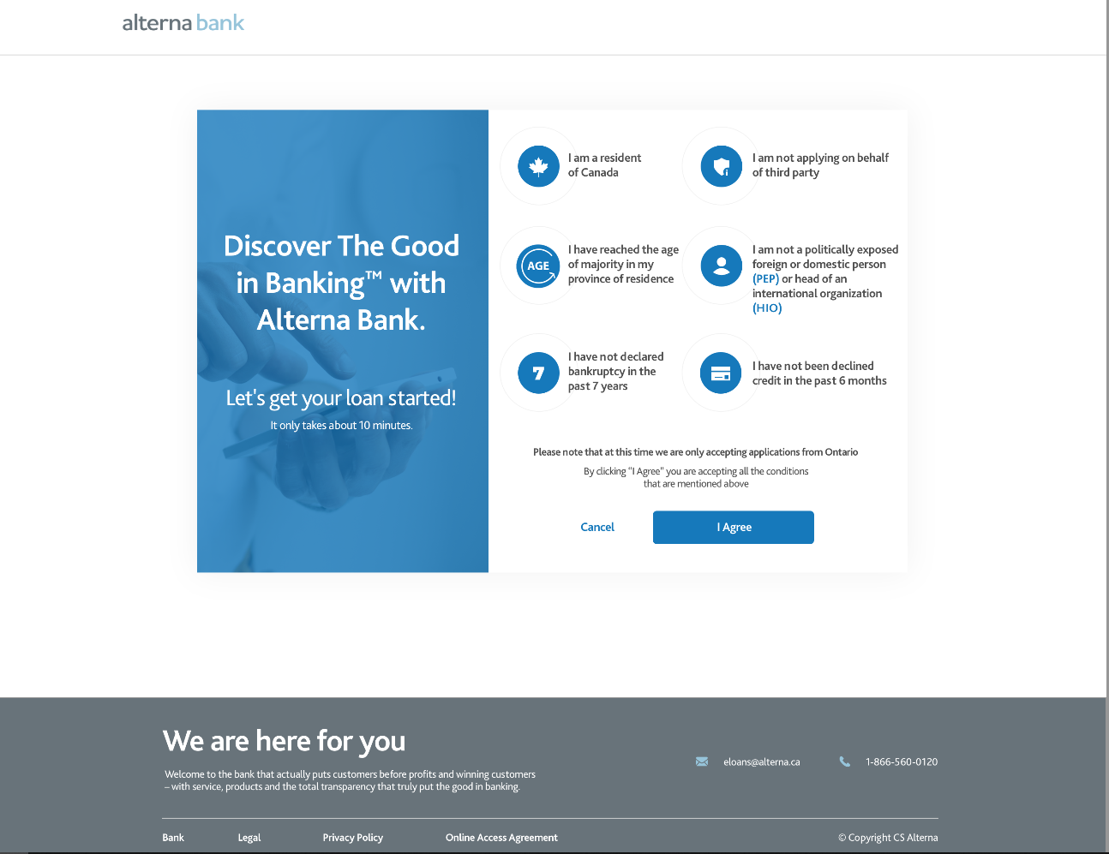
C-1
Customer first page

Slide 4
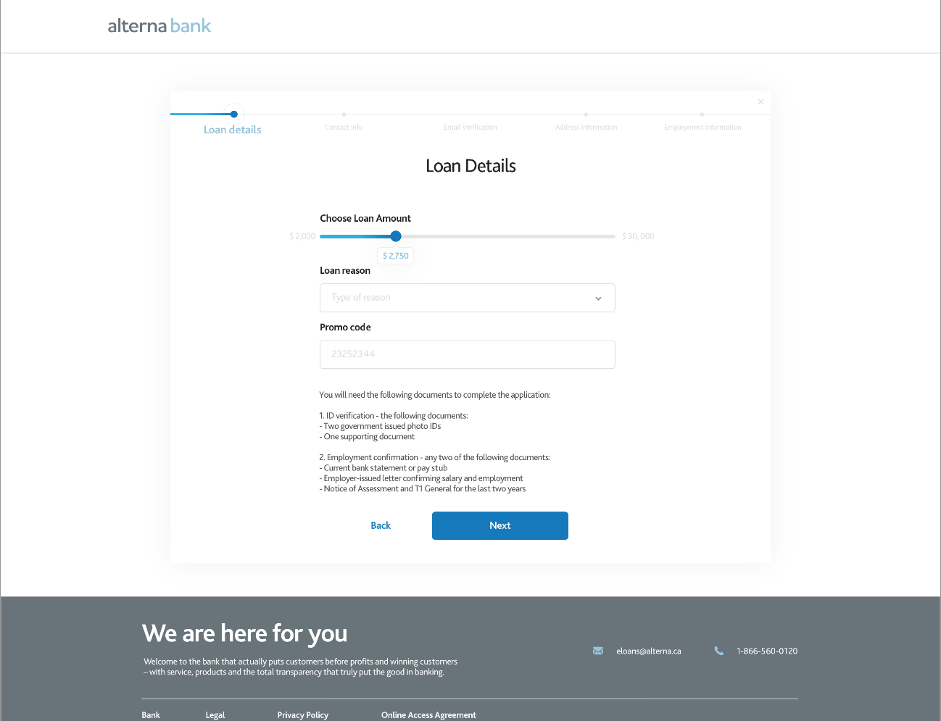
C-2

Slide 5
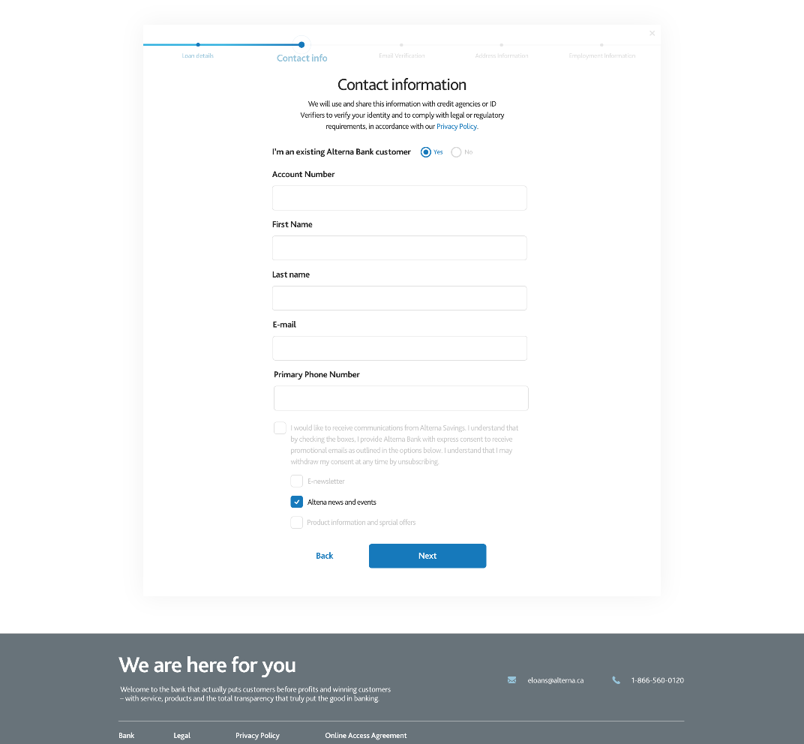
C-3

Slide 6
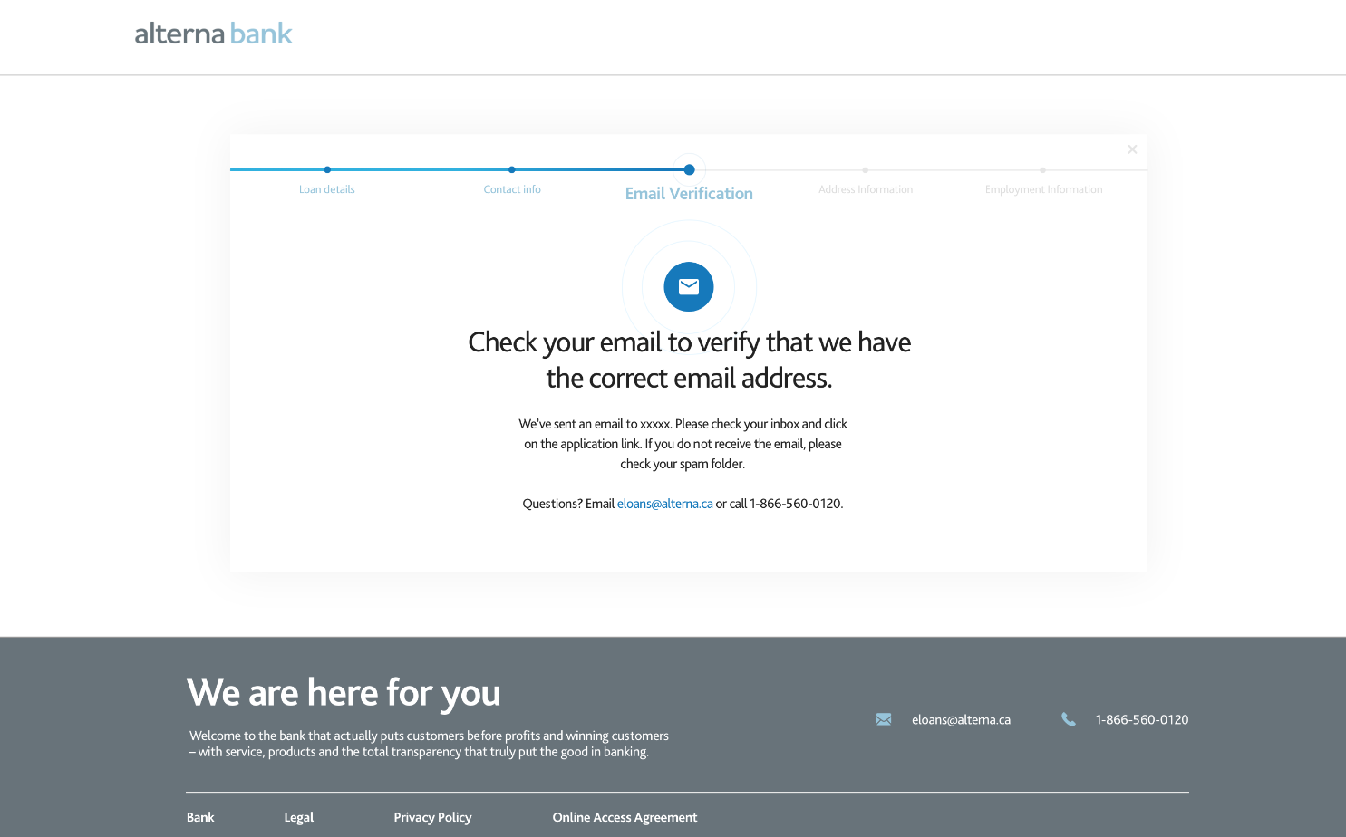

If for some reason, email issues, can we resend email link [WHO]
C-4
E-1
Verification of Email

Slide 7

Click on Email to validate email address

Slide 8
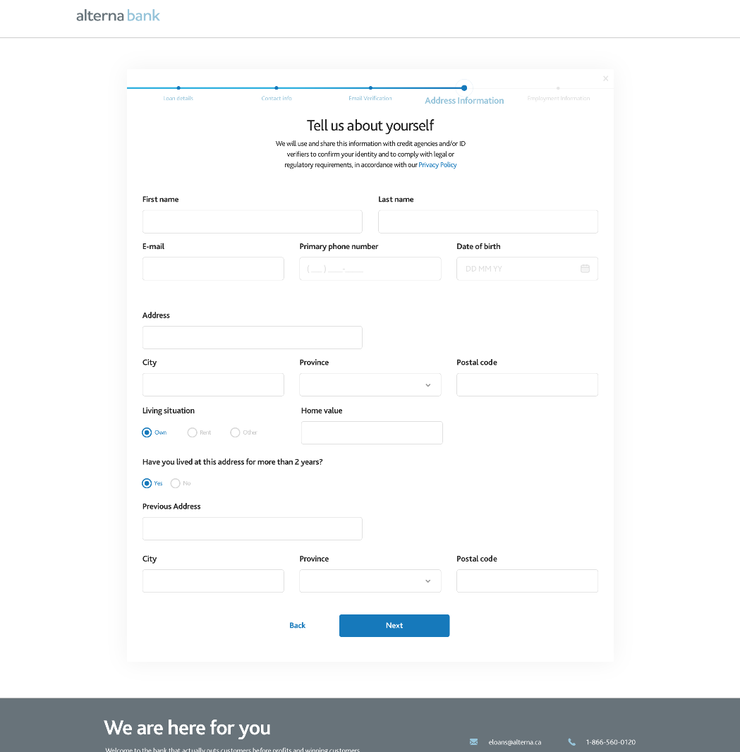
C-5
Customer LOGS back in
(from EMAIL)

Slide 9
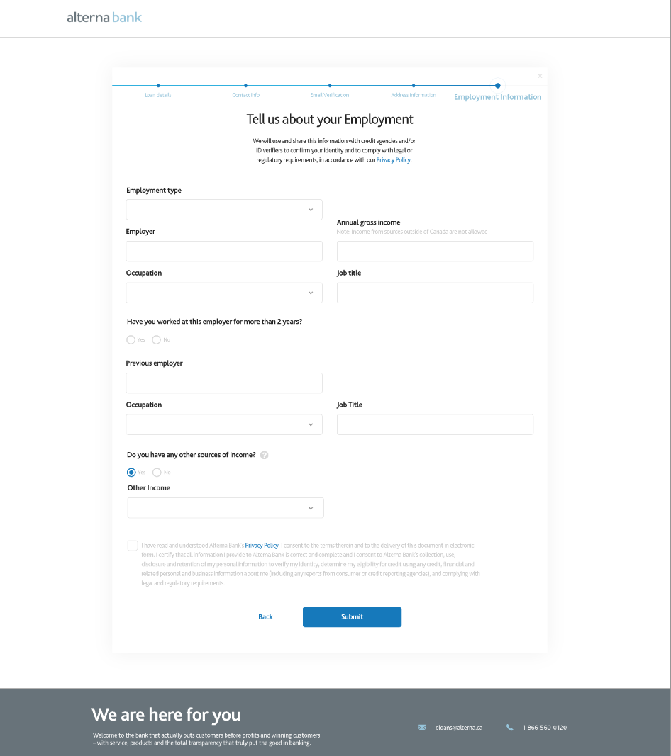
C-6

Slide 10


eID Verifier

Slide 11
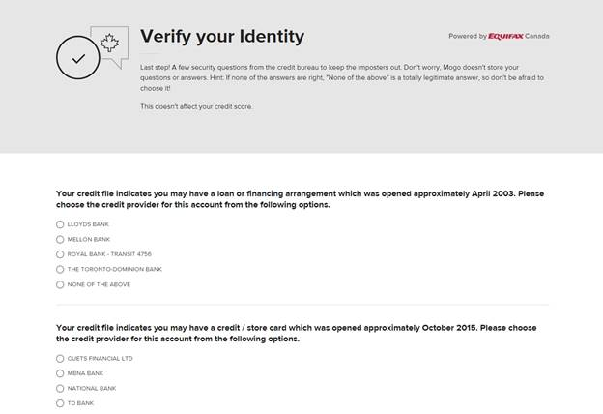
C-7

Slide 12
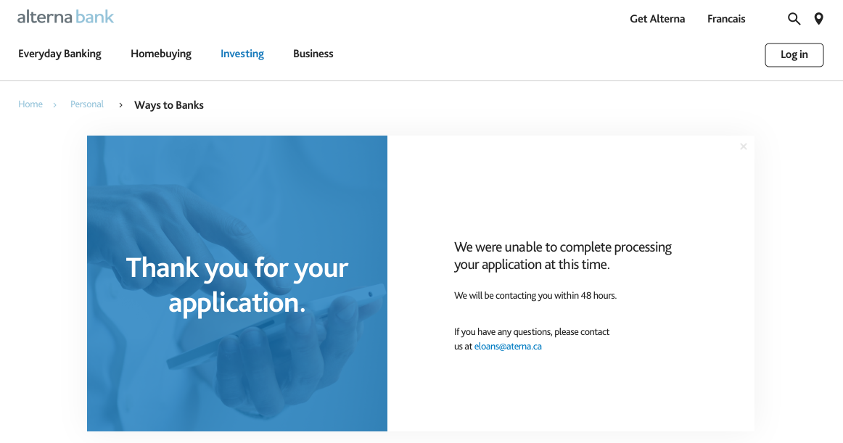
eID = N | R
Equifax Verifier was not able to identify the customer
Add New Screen for RETRIES
Amend verbiage to be same as C-7.1
Delete contact verbiage
C-7.1
TERMINAL

Slide 13

KYC AccountDetails
or
MANUAL UPLOAD

Slide 14
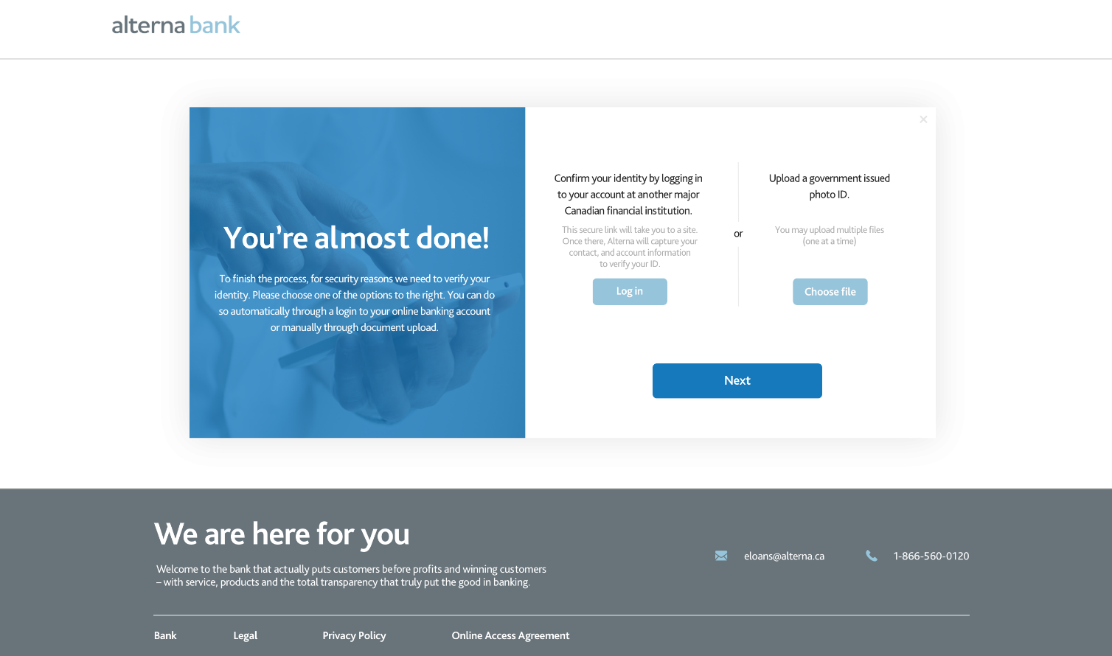
C-8
Upload utility bill, bank statement, or property tax

Slide 15
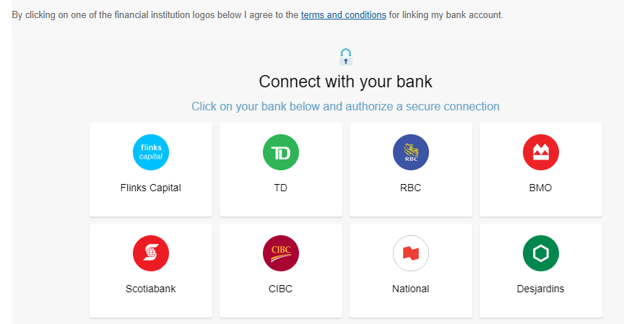
Note: Flinks Fraud checks NOT show stopper
C-8.1
Upload utility bill, bank statement, or property tax

Slide 16
Credit Bureau Soft Pull

Slide 17
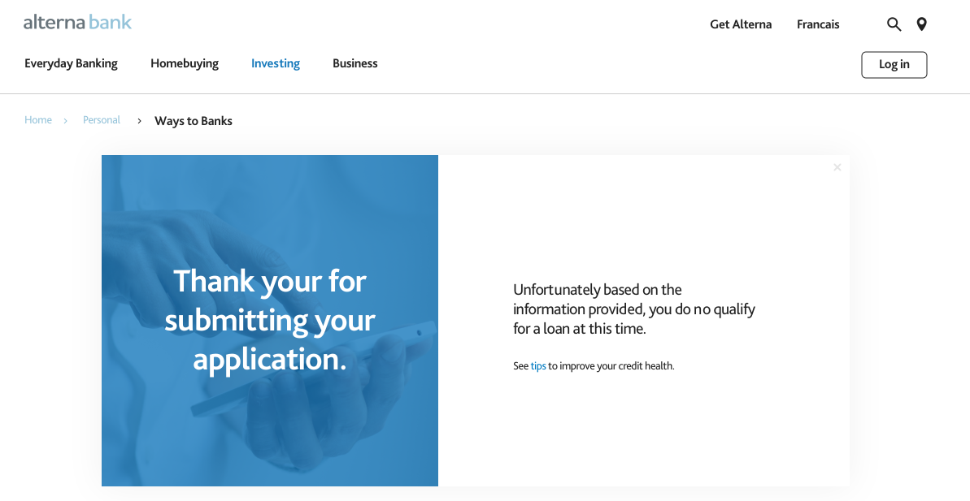
Situation where CB would result into NO data
Very improbable as Verifier passed
C-7.1
TERMINAL

Slide 18

Decision Engine Conditional approval

Slide 19
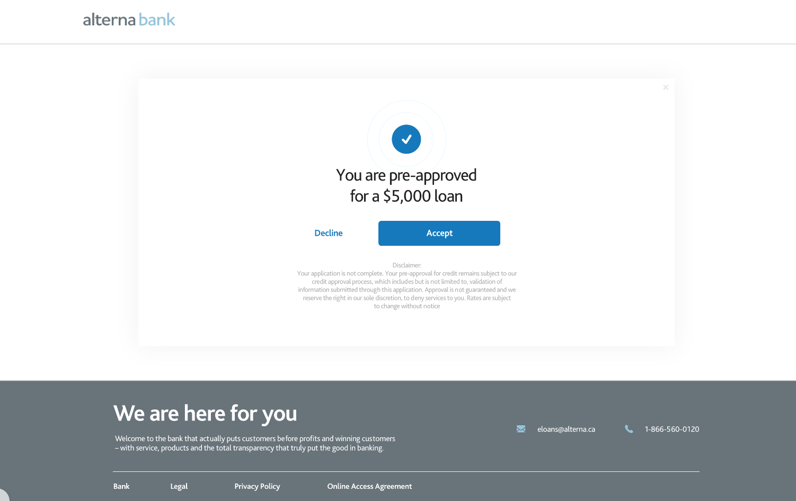
Use CONTINUE instead of ACCEPT
Add new screen thanking person if click Decline
C-9
Use “Proceed or Continue ” vs Accept

Slide 20
No loan could be approved for the customer
C-9.1

Slide 21
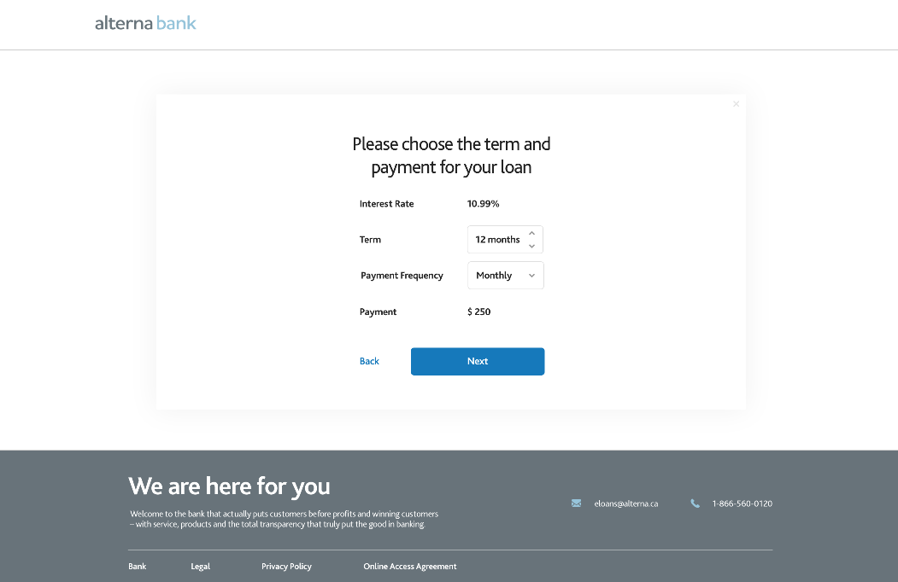
C-10

Slide 22
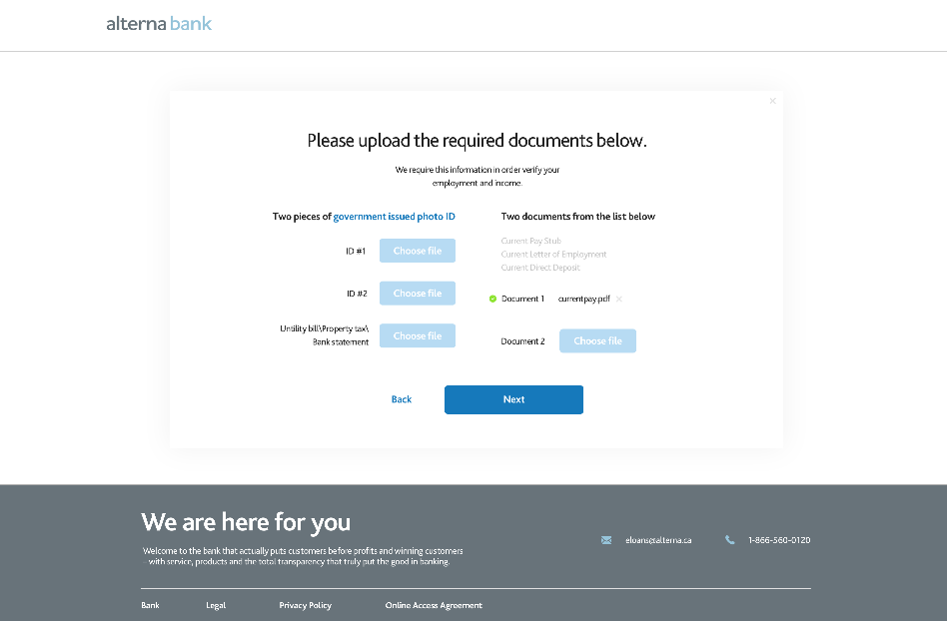
C-11

Slide 23
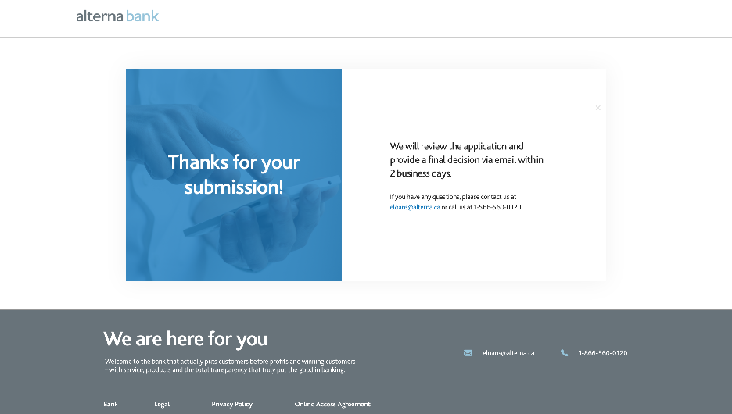
2 + 3 + X days
C-12
E-2
Verification of Application Submission

Slide 24

Full Adjudication MANUAL [RCSC]
Need more information [INTERNAL]
I-1
Your Loan has been approved
E-5
E-7
Your Loan has not been approved

Slide 25
C-12.1
TERMINAL
E-7
Your Loan has not been approved

Slide 26
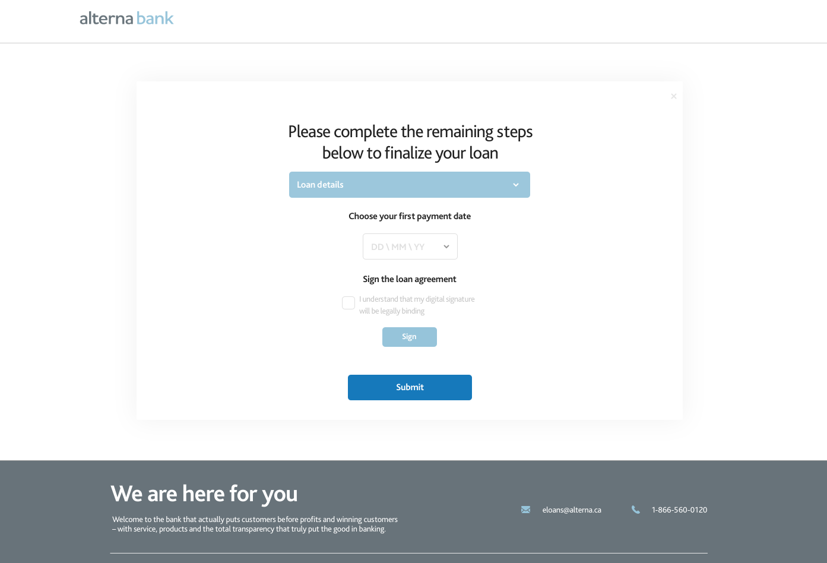
Congratulations
C-13
Customer LOGS back in
(from EMAIL)
E-5

Slide 27
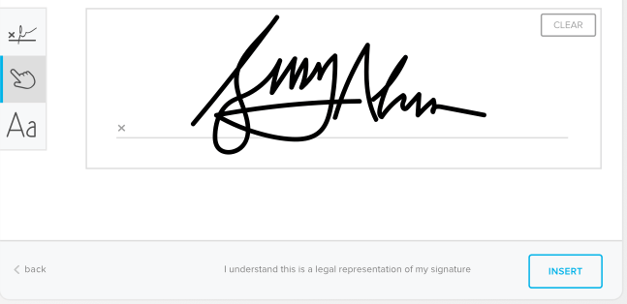
C-13.1

Slide 28
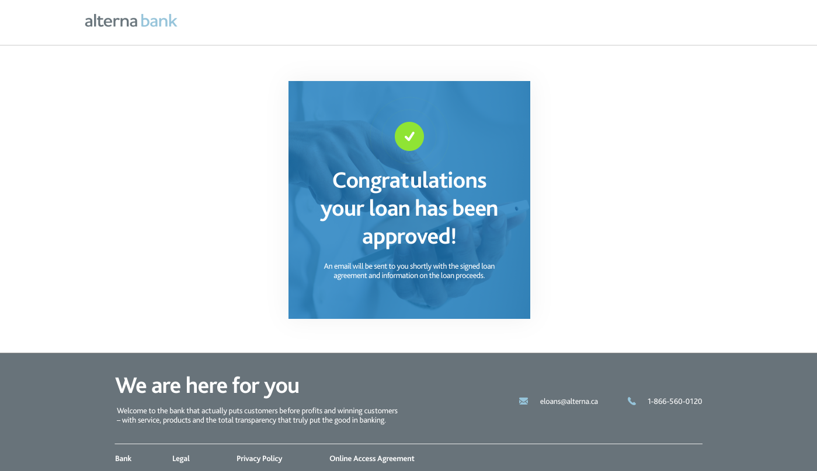
C-14

Slide 29
End
CUSTOMER TERMINAL

Slide 30

Funding
ADMIN TERMINAL
[Credit Ops]
I-2
Signed loan agreement + info on loan proceeds wen funded [INTERNAL – within 1 – 3days]

Slide 31
Fulfillment

Slide 32
ADMIN FLOW

Slide 33
QUEUES
based on application status
REJECTED
Failed: eID, CB or Decision Engine
N/A
HARD STOP
INCOMPLETE
“In between” applications
N/A
REVIEW
[FRAUD]
X days
APPROVED
[RCSC]
2 days
FUNDING
[Credit Ops]
2-3 days
COMPLETE

Slide 34
Queues
Approved
RCSC
Credit ops
Rejected
Fraud
RCSC
Review
RCSC
Fraud
Incomplete
Contact center
Funding
Credit ops
RCSC

Slide 35
ROLES AND RESPONSIBILITIES
Responsibilities:
Review the application and proof of income
Prior to Approval
Validate all the data fields in Credit Genie
validate the quality of the documents in admin module
Data transfer to WB
Send an email with the hello sign
Not Accountable:
Funding
Adjudication
SLA: 2 Business days
Responsibilities:
Set up the payments in WB
Prior to disbursement
Satisfy all the conditions assigned to the credit ops
Validate all data fields in WB,
confirm all documents have been signed
Complete funding of mortgage for the customer
Not accountable
Direct communication with the customer
Credit operations
SLA: 2 -3 Business days

Slide 36
Responsibilities:
Answering all the customer quires related to the member
Not Accountable:
Contact center
SLA: N/A
Fraud Team
SLA: X days
Responsibilities:
Reviewing the applications in the rejected / review queue
Customer interaction (if required)
Providing the decision from a fraud perspective

Slide 37
Appendix

Slide 38
List of Emails

Slide 39
Integration View
1
2
3
4
5
6
7
8
9
Client input personal and application details
eID Verifier
Flinks
CB Soft Pull
Decision Engine
Underwrite
Sign
Execute
Fund
Close
API
API
API
API
API

